Slide 1

Engineering Mathematics I
Welcome to AIT
Mr. Vitthal Hivrale
Assistant Professor
Mathematics

Slide 2
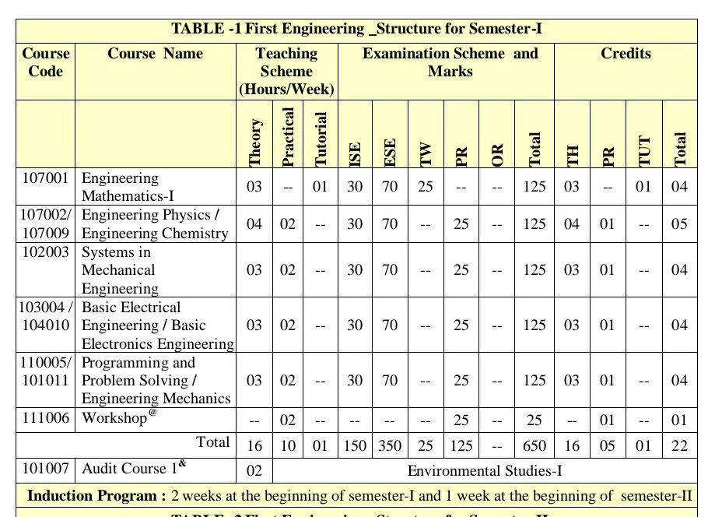
FE Semester Structure

Slide 3
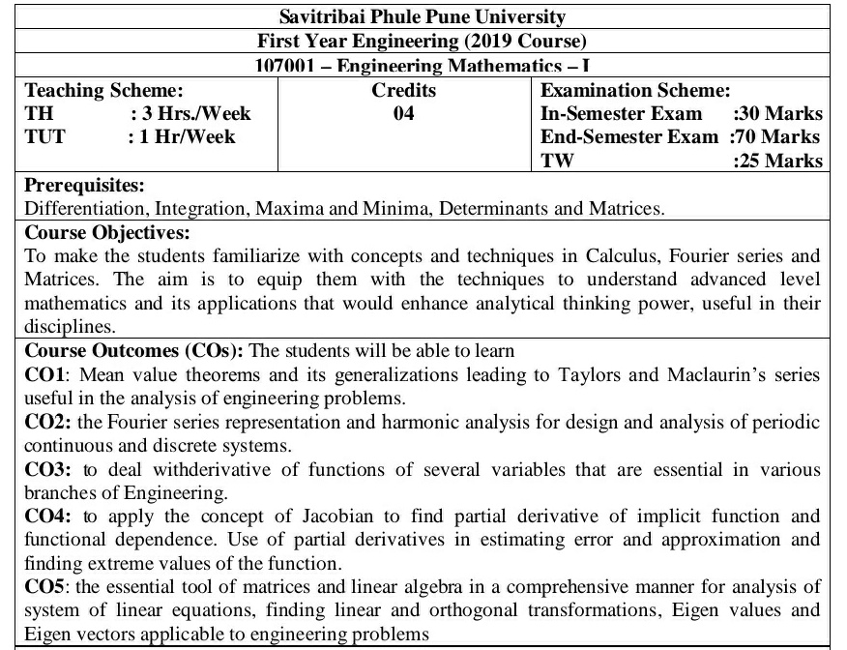
Course Objectives

Slide 4
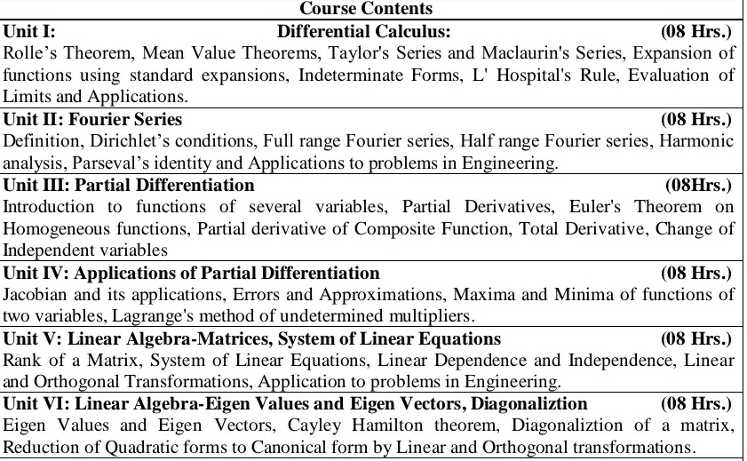
Course Contents

Slide 5
Unit I Differential Calculus
Topics to cover
Rolle’s Theorem and Mean Value Theorems
Taylor's Series and Maclaurin's Series
Indeterminate Forms of Limits

Slide 6
Objectives
To make the students familiarize with concepts and techniques in Calculus.
The students will be able to learn Mean value theorems and its generalizations leading to Taylors and Maclaurin’s series useful in the analysis of engineering problems.

Slide 7
Rolle’s Theorem
Suppose f(x) is a function that satisfies all of the following.
f(x) is continuous on the closed interval [a,b].
f(x) is differentiable on the open interval (a,b).
f(a) = f(b)
Then there is a number c such that a<c<b and f′(c)=0. Or, in other words f(x) has a critical point in (a,b).

Slide 8
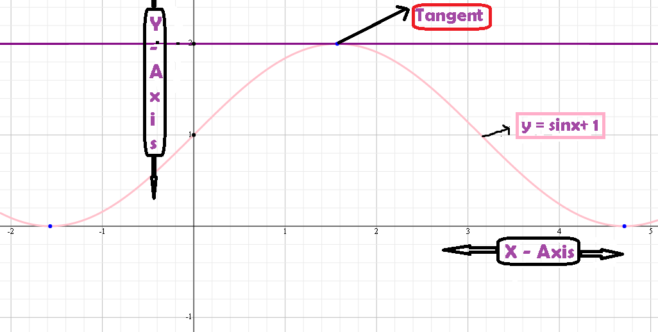
Graph of y= sin x +1

Slide 9
Always exists such tangents
Y-AXIS
f(a) = f(b)
(a, f(a)) (b, f(b))
X=a x= b X-AXIS

Slide 10
Why is continuity necessary?
Y-Axis
f(a) = f(b)
x = a x = c x = b
X-Axis

Slide 11
Why is differentiability necessary?
Y-Axis
f(a) = f(b)
X-Axis
x = a x = c x = b

Slide 12

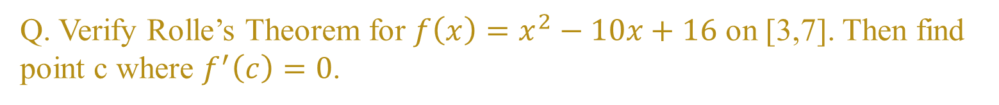

Q. Verify Rolle’s Theorem for $f\left(x\right)=x^{2}−10x+16$ on [3,7]. Then find point c where $f^{′}\left(c\right)=0$.
Answer
Step 1. Verify the conditions
Continuity : Polynomial functions are continuous over all real no.
Differentiability : Since polynomial function is always differentiable.
Equal End Points : $f\left(x\right)=x^{2}−10x+10$.
At x = 3 : $f\left(3\right)=\left(3^{2}\right)−10\left(3\right)+16$ => $f\left(3\right)=−5.$
At x = 7 : $f\left(7\right)=\left(7^{2}\right)−10\left(7\right)+16$ => $f\left(7\right)=−5.$
$$f\left(3\right)=f(7)$$

Slide 13
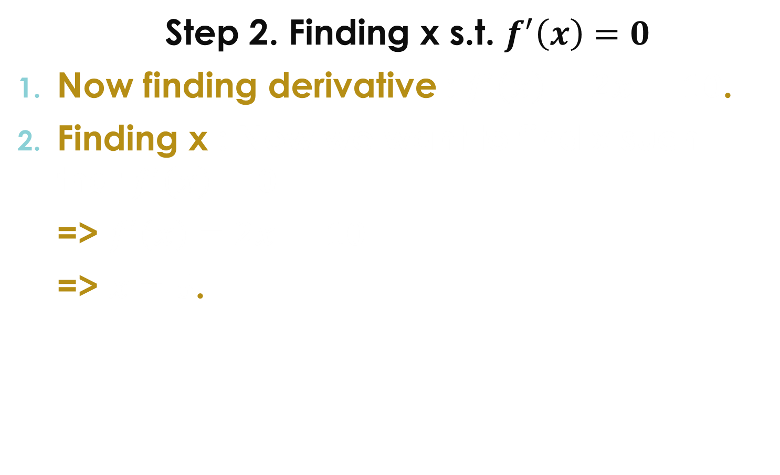
Step 2. Finding x s.t. $f^{′}\left(x\right)=0$
Now finding derivative : $f^{′}\left(x\right)=2x −10$.
Finding x : Now we want to find x such that $f^{′}\left(x\right)=0$
=> $f^{′}\left(x\right)=2x −10$
=> $x=5$.

Slide 14


Q. Verify Rolle’s Theorem for following functions on given intervals. Then find point c where $f^{′}\left(c\right)=0$.
$x+1, x≤3$ .
$f\left(x\right)$ for interval [1, 4].
$2+4x−x^{2}, x>3$.
2. $f\left(x\right)=x^{2}−5x+6$ on interval [2, 3].
3. f(x) = |x| for interval [-2,2]

Slide 15

Langrange’s Mean Value Theorem (LMVT)
Also known as MVT.
Statement :
Suppose f(x) is continuous on [a, b] and differentiable on (a,b), then there exists at least one value $c ε (a,b)$ such that
$f^{′}\left(c\right)=\frac{f\left(b\right)−f\left(a\right)}{b−a}$

Slide 16

Graphical Interpretation
Y-Axis Line whose slope is $\frac{f\left(b\right)−f\left(a\right)}{b−a}$
Tangent whose slope is f’(c)
X-Axis
x = a x = c x = b
Here we can observe the dotted line and the black line are parallel
Therefore $f′(c)=\frac{f\left(b\right)−f\left(a\right)}{b−a}$

Slide 17

Q. Verify LMVT for $f\left(x\right)=x(x−2)$ on [1,3].
ANSWER
Step 1 : Verify two conditions
Continuity : f(x) polynomial function so continuous on [1,3].
Differentiability : f(x) polynomial function so differentiable on (1,3).
By LMVT : There exists at least a c belonging to (1, 3) such that.
$f^{′}\left(c\right)=\frac{f\left(b\right)−f\left(a\right)}{b−a}$ => $f^{′}\left(c\right)=\frac{f\left(3\right)−f\left(1\right)}{3−1}$ -----→ (1)
Step 2 : Finding ‘c’
f’(c) : $f^{′}\left(x\right)=2x −2$ => $f^{′}\left(c\right)=2c−2.$
f(3) : $f(3)$ = 3(3-2) => f(3) = 3.
f(1) : $f(1)$ = 1(1-2) => f(3) = -1.
from equation (1)
$2c−2=\frac{3−\left(−1\right)}{3−1}=\frac{4}{2}=2$
=> $2c−2=2$
=> $c=2 ε (1, 3)$ => f’(c) = 2.

Slide 18

Q. Verify LMVT for following functions on given intervals.
$f\left(x\right)=2{\left(x−1\right)}^{2}−3$ on interval [a, 3]. Find the value of a so that LMVT is satisfied at x=2.
$f\left(x\right)=x^{2}$ on interval [1, 5].

